Slide 1
BEC105: Introduction to Electronics Engineering
ECE: Electronics (1)
Lecture 01: Diodes Applications & Special diode types
Prepared By
ECE department

Slide 2
Introduction
In this Lecture we will learn
application of the diode in the design of rectifier circuits, which convert ac voltages to dc as needed for powering electronic equipment.
a number of other practical and important applications: limiting and clamping circuits.
Special diode types: LED, Photo diode, Schottky diode, Varactor diode, Zener diode.

Slide 3
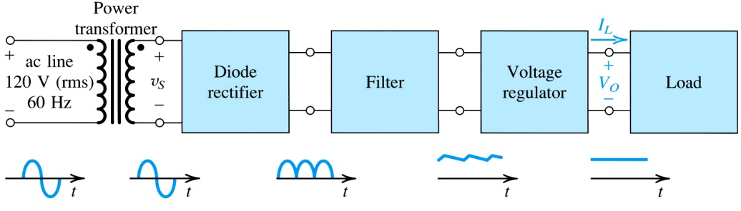
1.2. Rectifier Circuits
One important application of diode is the rectifier –
Electrical device which converts alternating current (AC) to direct current (DC)
One important application of rectifier is dc power supply.
Figure 1.20: Block diagram of a dc power supply

Slide 4

step #1: Decrease RMS magnitude of AC wave via power transformer
step #2: convert full-wave AC signal to full-wave rectified signal (still time-varying and periodic)
step #3: employ low-pass filter to reduce wave amplitude by > 90%
step #4: employ voltage regulator to eliminate ripple
step #5: supply dc load .
Figure 1.20: Block diagram of a dc power supply
Notes:
The diagrams indicate a “full-wave” rectifier.

Slide 5
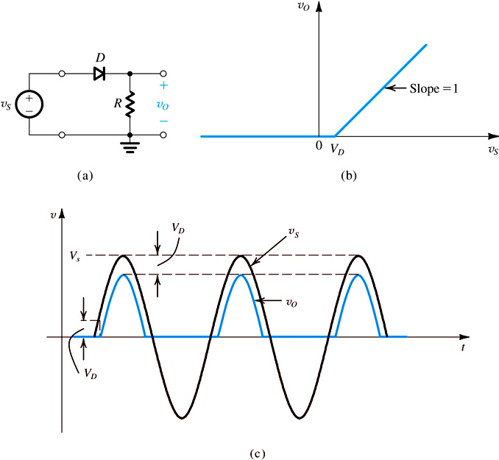
1.21. The Half-Wave Rectifier
half-wave rectifier – utilizes only alternate half-cycles of the input sinusoid
Constant voltage drop diode model is employed.
Figure 1.21: (a) Half-wave rectifier (b) Transfer characteristic of the rectifier circuit (c) Input and output waveforms

Slide 6
1.21. The Half-Wave Rectifier
In selecting diodes for rectifier design, two important parameters must be specified:
current-handling capability – what is maximum forward current diode is expected to conduct?
peak inverse voltage (PIV) – what is maximum reverse voltage it is expected to block w/o breakdown?
It is usually prudent to select a diode that has a reverse breakdown voltage at least 50% greater than the expected PIV.
Notes:
In selecting diodes for rectifier design, two important parameters must be specified: the current-handling capability required of the diode, determined by the largest current the diode is expected to conduct, and
the peak inverse voltage (PIV) that the diode must be able to withstand without breakdown, determined by the largest reverse voltage that is expected to appear across the diode. In the rectifier circuit of Fig. 4.21(a), we observe that when vS is negative the diode will be cut off and vO will be zero. It follows that the PIV is equal to the peak of vS ,

Slide 7
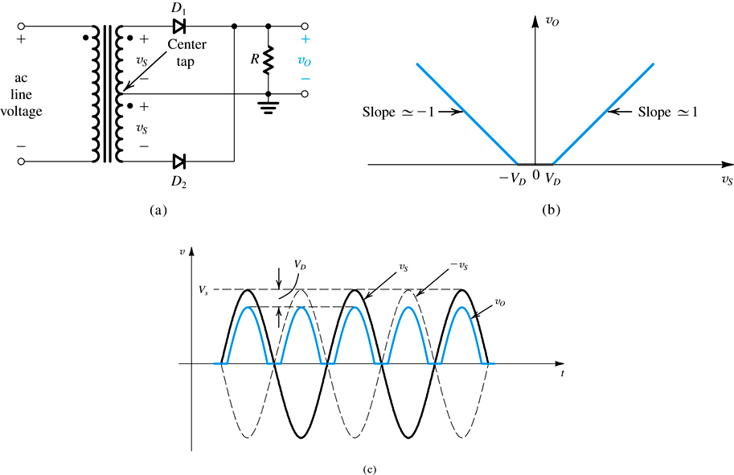
1.22. The Full-Wave Rectifier
Q: How does full-wave rectifier differ from half-wave?
A: It utilizes both halves of the input
One potential is shown to right.
Figure 1.22: Full-wave rectifier utilizing a transformer with a center-tapped secondary winding.

Slide 8
Figure 1.22: full-wave rectifier utilizing a transformer with a center-tapped secondary winding: (a) circuit; (b) transfer characteristic assuming a constant-voltage-drop model for the diodes; (c) input and output waveforms.

Slide 9
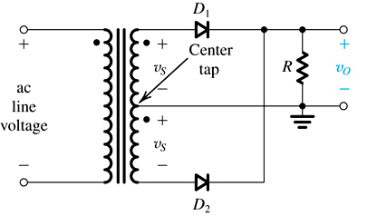

Slide 10
When instantaneous source voltage is positive, D₁ conducts while D₂ blocks…

Slide 11
when instantaneous source voltage is negative, D₂ conducts while D₁ blocks

Slide 12
1.22. The Full-Wave Rectifier
Q: What are most important observation(s) from this operation?
A: The direction of current flowing across load never changes (both halves of AC wave are rectified). The full-wave rectifier produces a more “energetic” waveform than half-wave.
PIV for full-wave = 2V_{S} – V_{D}

Slide 13
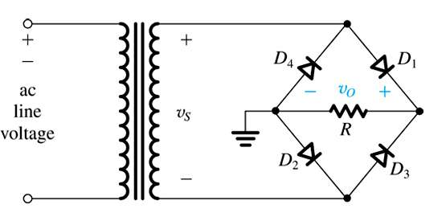
1.23. The Bridge Rectifier
An alternative implementation of the full-wave rectifier is bridge rectifier.
Shown to right.
Figure 1.23: The bridge rectifier circuit.
Notes:
You can buy Bridge Rectifier modules at Radio Shack.

Slide 14
when instantaneous source voltage is positive, D₁ and D₂ conduct while D₃ and D₄ block
Figure 1.23: The bridge rectifier circuit.

Slide 15
when instantaneous source voltage is positive, D₁ and D₂ conduct while D₃ and D₄ block
Figure 1.23: The bridge rectifier circuit.

Slide 16
1.23: The Bridge Rectifier (BR)
Q: What is the main advantage of BR?
A: No need for center-tapped transformer.
Q: What is main disadvantage?
A: Series connection of TWO diodes will reduce output voltage.
PIV = V_{S} – V_{D}
Notes:
Also you need to be careful to control grounds!

Slide 17
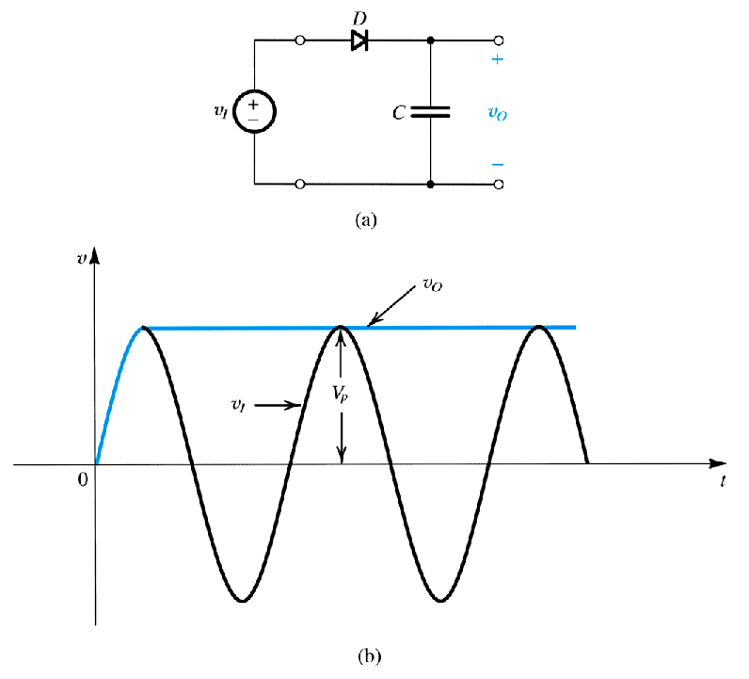
1.24. The Rectifier with a Filter Capacitor
Pulsating nature of rectifier output makes unreliable dc supply.
As such, a filter capacitor is employed to remove ripple.
Figure 1.24: (a) A simple circuit used to illustrate the effect of a filter capacitor. (b) input and output waveforms assuming an ideal diode.
Notes:
Reduce ripple, not remove it.

Slide 18
1.24. The Rectifier with a Filter Capacitor
step #1: source voltage is positive, diode is forward biased, capacitor charges.
step #2: source voltage is reverse, diode is reverse-biased (blocking), capacitor cannot discharge.
step #3: source voltage is positive, diode is forward biased, capacitor charges (maintains voltage).
Figure 1.24 (a) A simple circuit used to illustrate the effect…

Slide 19
1.24. The Rectifier with a Filter Capacitor
Q: Why is this example unrealistic?
A: Because for any practical application, the converter would supply a load (which in turn provides a path for capacitor discharging).

Slide 20
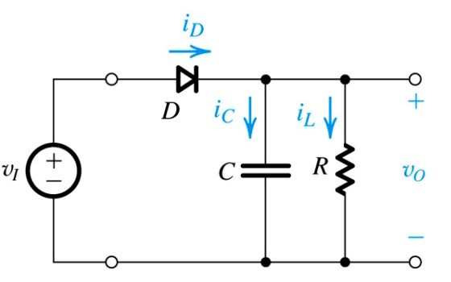
1.24. The Rectifier with a Filter Capacitor
Q: What happens when load resistor is placed in series with capacitor?
A: One must now consider the discharging of capacitor across load.

Slide 21
1.24. The Rectifier with a Filter Capacitor
circuit state #1
circuit state #2
Notes:
Laplace transforms are introduced in both the Differential Equations math course and the second Circuits course. They are heavily used in the Signals and Systems and Feedback Control courses.

Slide 22
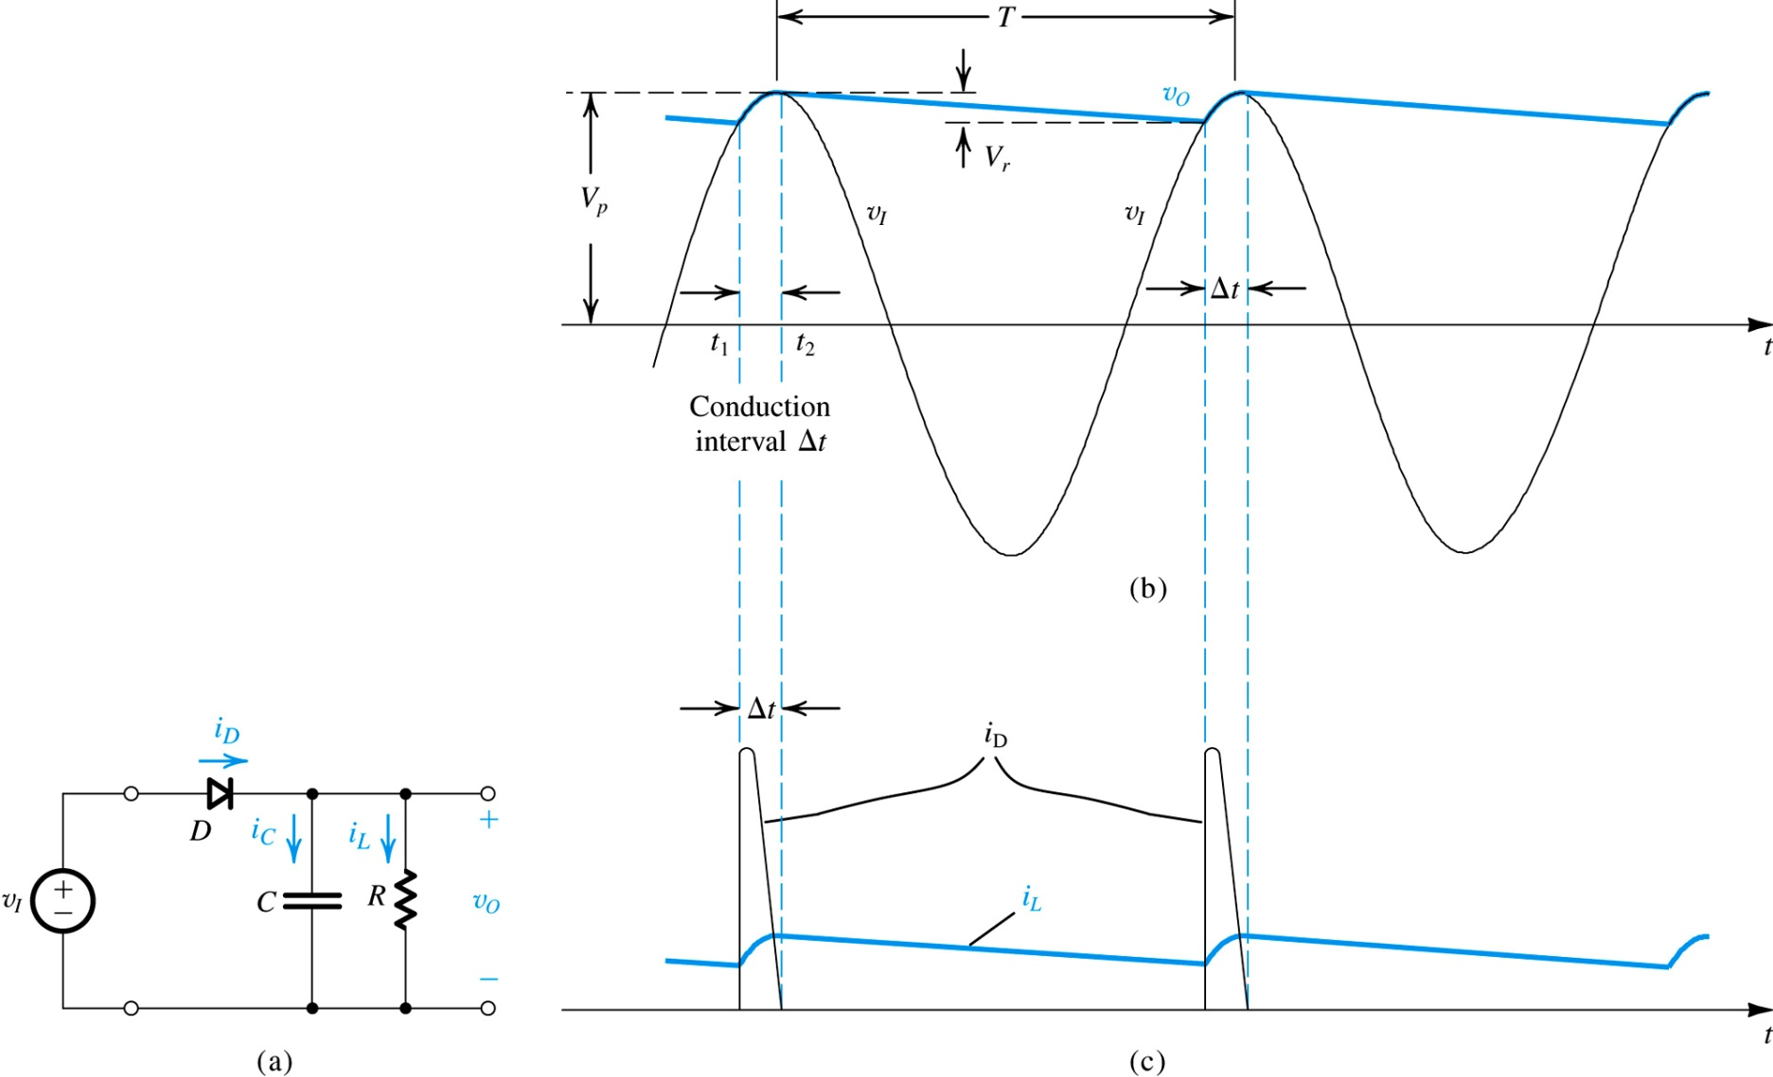
Figure 1.25: Voltage and Current Waveforms in the Peak Rectifier Circuit WITH RC >> T. The diode is assumed ideal.
Notes:
So in the steady state:
The diode conducts when the input voltage is above the capacitor voltage and the capacitor charges up to the peak voltage of the sinusoid.
When the input voltage is below the capacitor voltage, the capacitor discharges due to the load current. The discharge is approximately linear if the ripple is small.

Slide 23
A Couple of Observations
The diode conducts for a brief interval (Δt) near the peak of the input sinusoid and supplies the capacitor with charge equal to that lost during the much longer discharge interval. The latter is approximately equal to T.
Assuming an ideal diode, the diode conduction begins at time t₁ (at which the input v_{I} equals the exponentially decaying output v_{O}). Diode conduction stops at time t₂ shortly after the peak of v_{I} (the exact value of t₂ is determined by settling of I_{D}).

Slide 24
A Couple of Observations
During the diode off-interval, the capacitor C discharges through R causing an exponential decay in the output voltage (v_{O}). At the end of the discharge interval, which lasts for almost the entire period T, voltage output is defined as follows – v_{O}(T) = V_{peak} – V_{r}.
When the ripple voltage (V_{r}) is small, the output (v_{O}) is almost constant and equal to the peak of the input (v_{I}). the average output voltage may be defined as below…

Slide 25
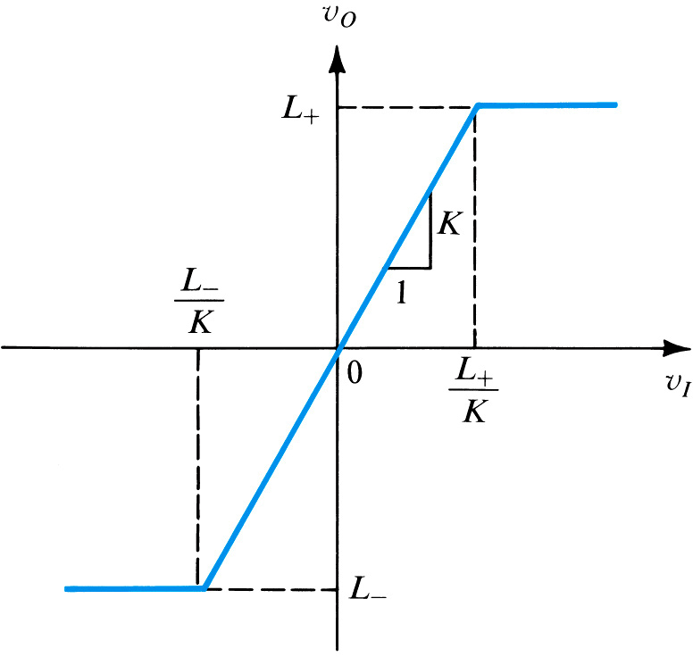
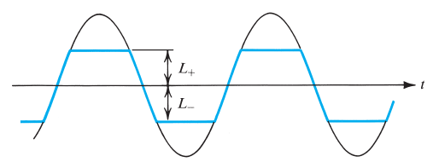


1.25: Limiting and Clamping Circuits
Q: What is a limiter circuit?
A: One which limits voltage output.
Figure 1.26: General transfer characteristic for a limiter circuit
$$v_{i}$$
$$v_{o}$$
Notes:
Shown is a symmetric limiter.

Slide 26
1.26. Limiting and Clamping Circuits
passive limiter circuit
has linear range
has nonlinear range
K < 1
examples include
single limiter operate in uni-polar manner
double limiter operate in bi-polar manner

Slide 27
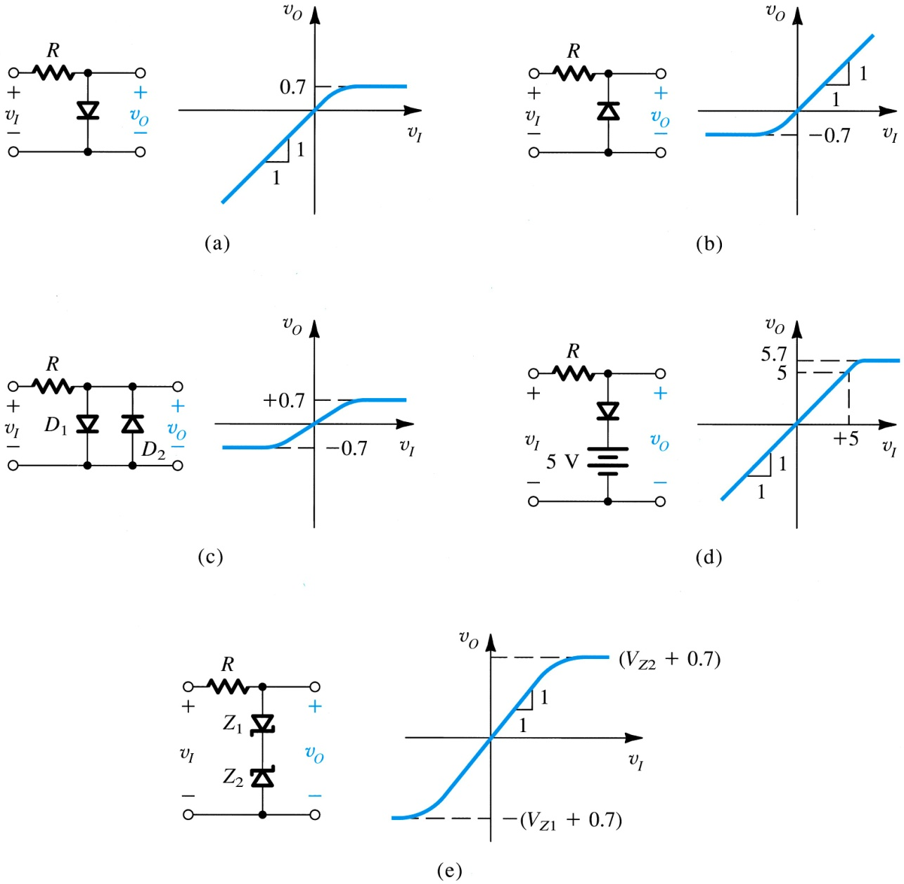
single limiters employ one diode
double limiters employ two diodes of opposite polarity
linear range may be controlled via string of diodes and dc sources
zener diodes may be used to implement soft limiting
Figure 1.26: Variety of basic limiting circuits.

Slide 28
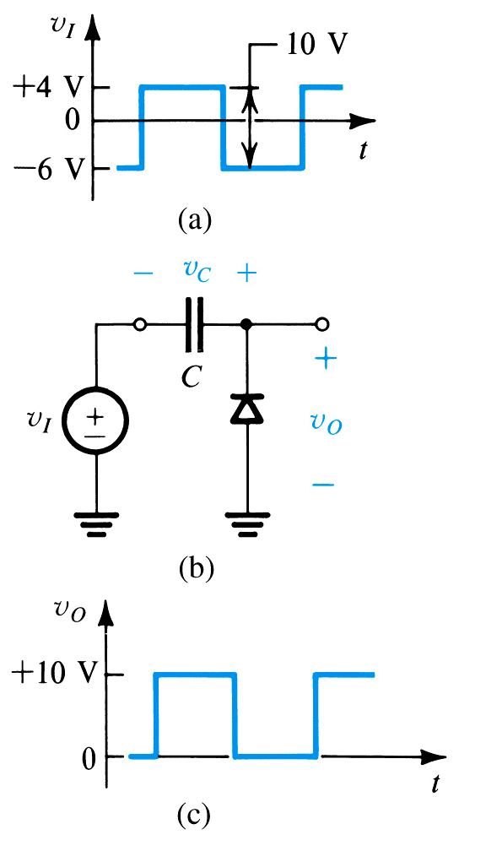
1.27. The Clamped Capacitor or DC Restorer
Q: What is a dc restorer?
A: Circuit which removes the dc component of an AC wave.
Q: Why is this ability important?
A: Average value of this output is effective way to measure duty cycle
Figure 1.27: The clamped capacitor or dc restorer with a square-wave input and no load
Notes:
You can restore the DC value to any desired amount by connecting the diode to a voltage source.

Slide 29
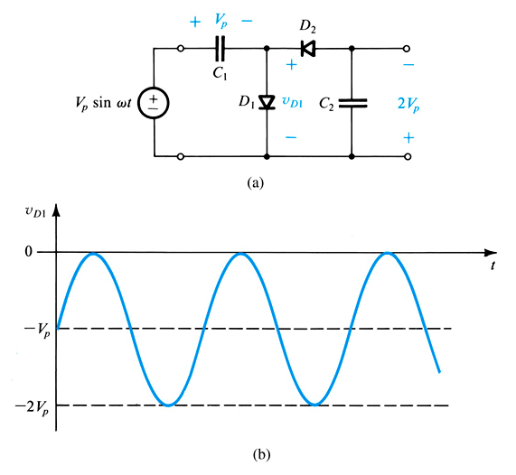
1.28: The Voltage Doubler
Q: What is a voltage doubler?
A: One which multiplies the amplitude of a wave or signal by two.
Figure 1.28: Voltage doubler: (a) circuit; (b) waveform of the voltage across D₁.
Notes:
But it has the ripple period of a half wave rectifier.

Slide 30
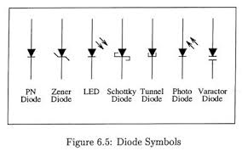
Special Diode Types

Slide 31
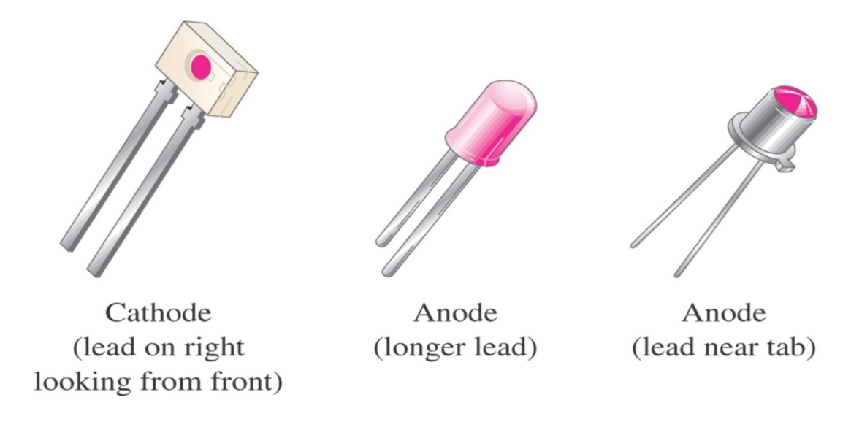
Optical Diodes
There are two popular types of optoelectronic devices:
light-emitting diode (LED) and photodiode.
The Light-Emitting Diode (LED)
LED is diode that emits light when biased in the forward direction of p-n junction.
Anode
Cathode
The schematic symbol and construction features.

Slide 32
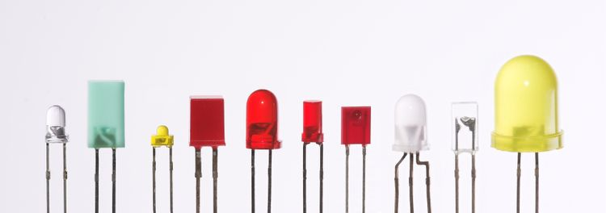
The Light-Emitting Diode (LED)
LED that are produced in an array of shapes and sizes.
LED characteristics:
characteristic curves are very similar to those for p-n junction diodes
higher forward voltage (V_{F})
lower reverse breakdown voltage (V_{BR}).

Slide 33
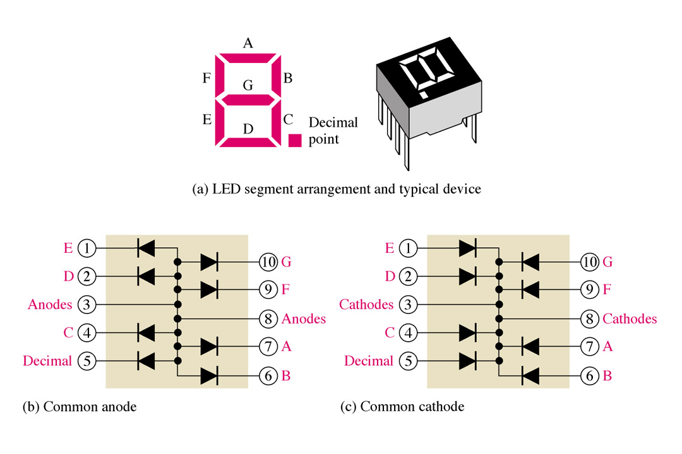
The Light-Emitting Diode (LED)
Application
The seven segment display is an example of LEDs use for display of decimal digits.
The 7-segment LED display.

Slide 34
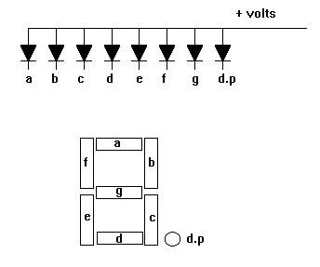
LED Displays
LED displays are packages of many LEDs arranged in a pattern, the most familiar pattern being the 7-segment displays for showing numbers (digits 0-9).

Slide 35
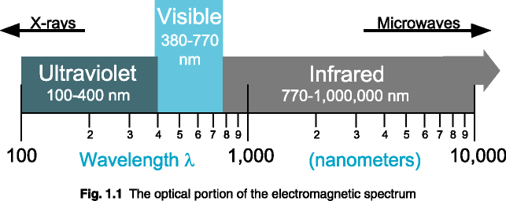
The Light-Emitting Diode (LED)
Light Spectrum
Red, green and blue LEDs

Slide 36

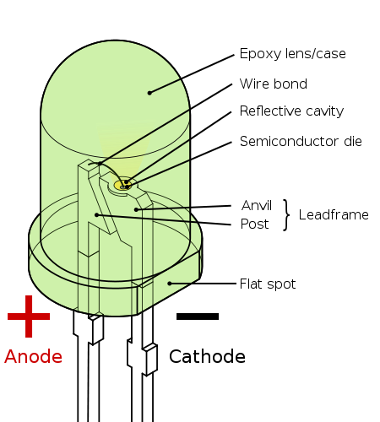
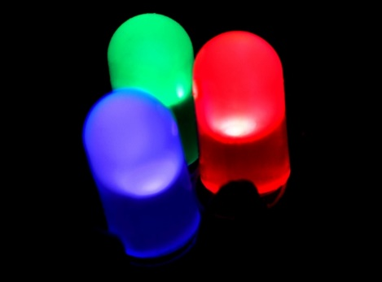
The Light-Emitting Diode (LED)
When a light-emitting diode is forward biased, electrons are able to recombine with holes within the device, releasing energy in the form of photons.
This effect is called electroluminescence and the color of the light (corresponding to the energy of the photon) is determined by the energy gap of the semiconductor.
Fabricating the pn junction using a semiconductor of the type known as direct-bandgap materials.

Slide 37
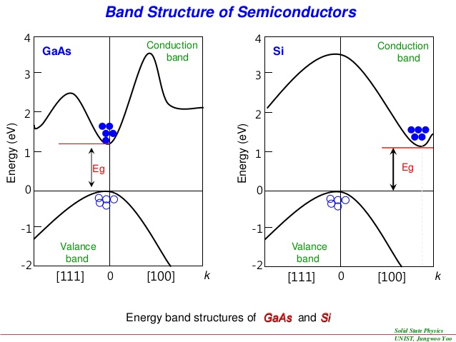
The Light-Emitting Diode (LED)
Radiative recombination
Non-radiative recombination

Slide 38
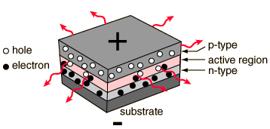
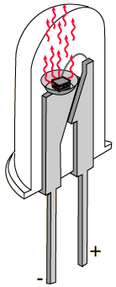
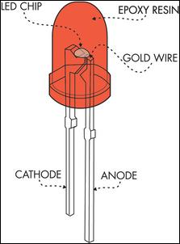
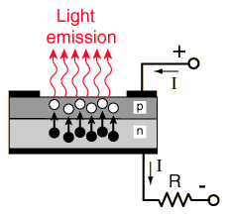
LED - Light Emitting Diodes
UV – AlGaN
Blue – GaN, InGaN
Red, green – GaP
Red, yellow – GaAsP
IR- GaAs

Slide 39

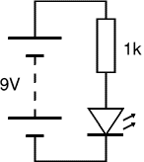
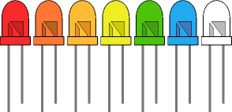
Testing an LED
Never connect an LED directly to a battery or a power supply! It will be destroyed almost instantly because too much current will pass through and burn it out.
LEDs must have a resistor in series to limit the current to a safe value, for quick testing purposes a 1kΩ resistor is suitable for most LEDs if your supply voltage is 12V or less.
Remember to connect the LED the correct way!

Slide 40
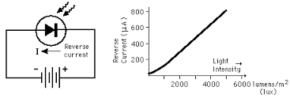
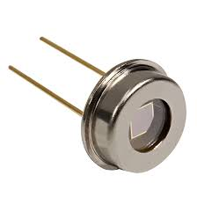
The Photodiode
Photodiode is a p-n junction that can convert light energy into electrical energy.
It operates in reverse bias voltage (V_{R}), as shown in Figure, where I_{λ} is the reverse light current.
It has a small transparent window that allows light to strike the p-n junction.
The resistance of a photodiode is calculated by the formula as follows:
I_{λ}

Slide 41
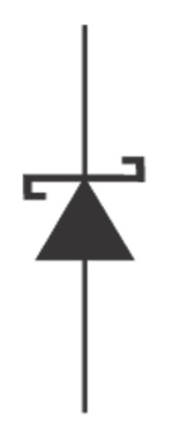
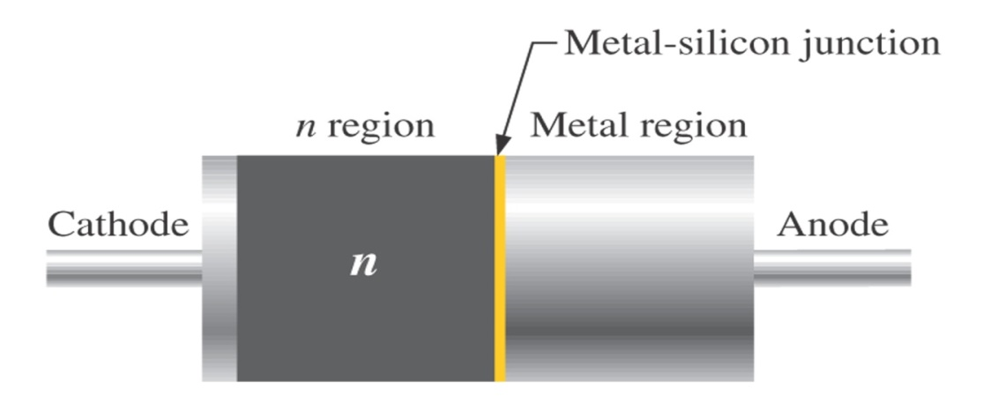
The Schottky Diode
The Schottky diode’s significant characteristic is its fast switching speed.
This is useful for high frequencies and digital applications.
It is not a typical diode in that it does not have a p-n junction.
Instead, it consists of a doped semiconductor (usually n-type) and metal bound together.
Schottky diode (a) symbol and (b) basic internal construction

Slide 42


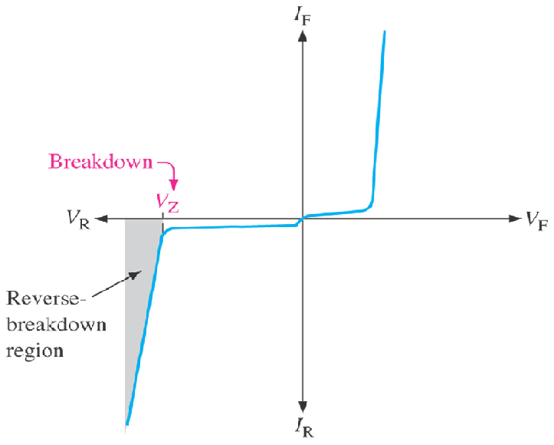
Zener Diode
Cathode (K)
K
Zener diode is a p-n junction diode that is designed to operate in the reverse breakdown region.
Two things happen when the reverse breakdown voltage (V_{BR}) is reached:
The diode current increases
drastically.
The reverse voltage (V_{R}) across
the diode remains relatively
constant.
In other words, the voltage across a zener diode operated in this region is relatively constant over a range of reverse current and nearly equal to its zener voltage (V_{Z}) rating.
+
V_{Z}
I_{Z}
−
Anode (A)
A
V_{BR}
Zener diode voltage-curent (V-I) characteristic.

Slide 43
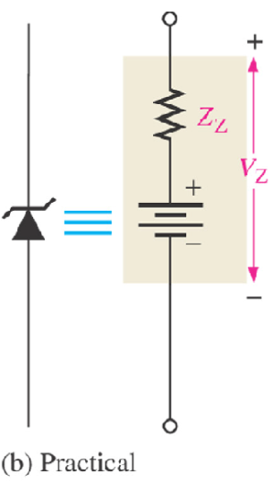
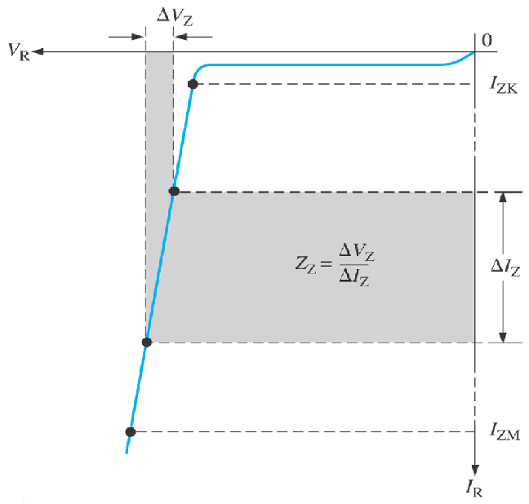
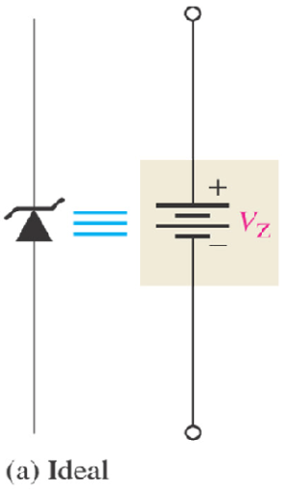
Zener Diode
Ideal-and-Practical Zener Equivalent Circuits
I_{F}
V_{Z}
V_{R}
V_{F}
I_{R}
Ideal model and characteristic curve of a zener diode in reverse breakdown.
The constant voltage drop = the nominal zener voltage.
Practical model and characteristic curve of a zener diode, where the zener impedance (resistance), Z_{Z} is included.
A change in zener current (ΔI_{Z}) produces a small change in zener voltage (ΔV_{Z}).

Slide 44
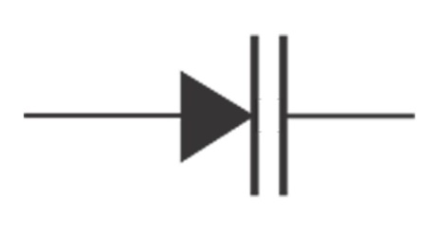
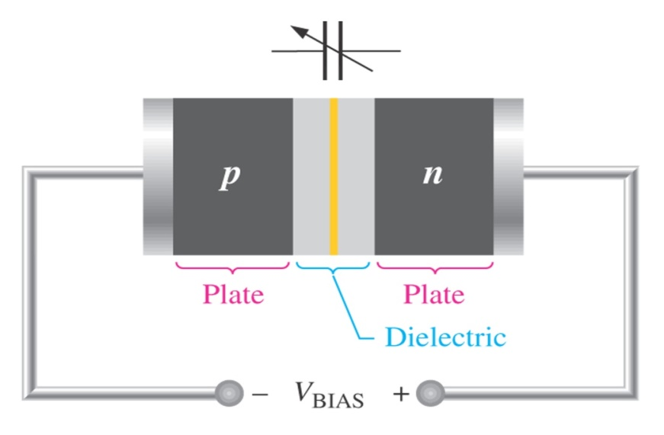
Varactor (Varicap Diode)
Varactor is a type of p-n junction diode that operates in reverse bias. The capacitance of the junction is controlled by the amount of reverse bias.
Varactor diodes are also referred to as varicaps or tuning diodes and they are commonly used in communication systems.
Basic Operation
The capacitance of a reverse-biased varactor junction is found as:
Varactor diode symbol
C = the total junction capacitance.
A = the plate area.
ε = the dielectric constant (permittivity).
d = the width of the depletion region
(plate separation).
Reverse-biased varactor diode acts as a variable capacitor.

Slide 45
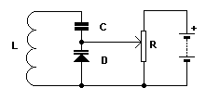
Varactor (Varicap Diode)
When the junction diode is reverse biased, the insulating barrier widens reducing diode capacitance.
The barrier forms the dielectric, of variable width, of a capacitor.
The N and P type cathode and anode are the two plates of the capacitor.
In the diagram, the diode and coil form a resonant circuit.
The capacitance of the diode, and thereby the resonant frequency, is varied by means of the potentiometer controlling the reverse voltage across the varicap.
The capacitor prevents the coil shorting out the voltage across the potentiometer.

Slide 46
Summary (1)
Rectifiers convert ac voltage into unipolar voltages. Half-wave rectifiers do this by passing the voltage in half of each cycle and blocking the opposite-polarity voltage in the other half of the cycle.
The bridge-rectifier circuit is the preferred full-wave rectifier configuration.

Slide 47
Summary (2)
The variation of the output waveform of the rectifier is reduced considerably by connecting a capacitor C across the output load resistance R. The resulting circuit is the peak rectifier. The output waveform then consists of a dc voltage almost equal to the peak of the input sine wave, V_{p}, on which is superimposed a ripple component of frequency 2f (in the full-wave case) and of peak-to-peak amplitude V_{r} = V_{p}/2fRC.

Slide 48
Summary (3)
Combination of diodes, resistors, and possible reference voltage can be used to design voltage limiters that prevent one or both extremities of the output waveform from going beyond predetermined values – the limiting levels.
Applying a time-varying waveform to a circuit consisting of a capacitor in series with a diode and taking the output across the diode provides a clamping function.
By cascading a clamping circuit with a peak-rectifier circuit, a voltage doubler is realized.

Slide 49
Summary (4)
Beyond a certain value of reverse voltage (that depends on the diode itself), breakdown occurs and current increases rapidly with a small corresponding increase in voltage.
Diodes designed to operate in the breakdown region are called zener diodes. They are employed in the design of voltage regulators whose function is to provide a constant dc voltage that varies little with variations in power supply voltage and / or load current.

